Slide 1
Unit 2
Hypertext Markup Language
(HTML-5):

Slide 2
Assignment 1: Student Details Table
Create an HTML page and design a table to display student details.
Table Columns:
Register Number
Name
Department
Year
Email
Add a table heading called "Student Information".

Slide 3
College Time Table using Table Tags
To create an HTML table using <table>, <tr>, <td>, colspan, and rowspan.
Instructions:
Create a table showing class timetable for 5 days.
Add 6 rows and 6 columns.
Use:
colspan for Lunch Break
rowspan for lab sessions
Add border to the table.

Slide 4
HTML
HTML is the standard markup language for Web pages.
With HTML you can create your own Website.
HTML is easy to learn - You will enjoy it!

Slide 5
HTML (HyperText Markup Language) is the core language used to structure and display content on the web, defining elements like text, images, links, and page layout so browsers can render websites properly.
Provides the basic structure for all web pages using opening and closing tags like <p>, <h1>, and <div>.
Supports text, images, links, lists, tables, forms, and multimedia elements such as audio and video.
Works with CSS for styling and JavaScript for interactivity.
Uses attributes like src, href, and alt to add extra information and control element behavior.

Slide 6
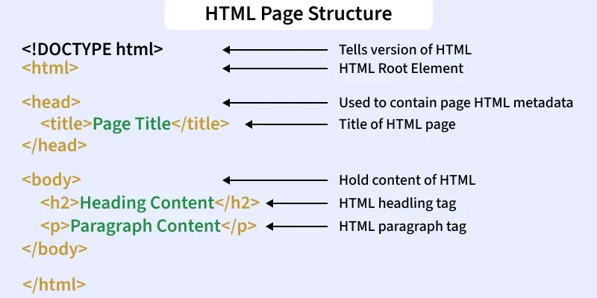
HTML STRUCTURE

Slide 7
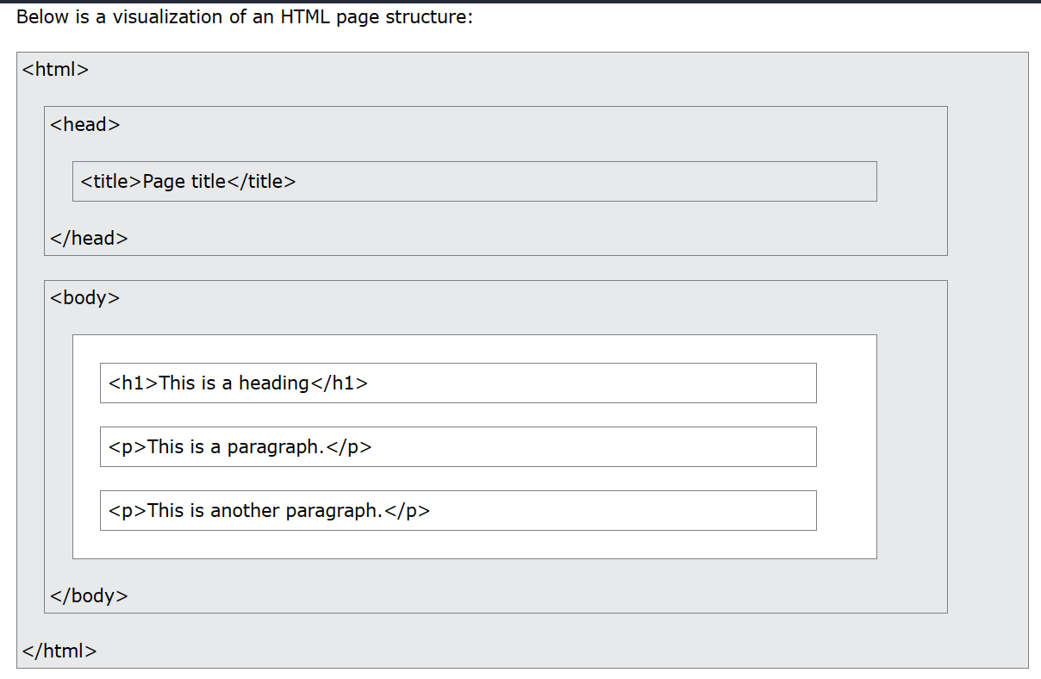

Slide 8
HTML CODING CONVENTIONS
HTML is used to create the structure of a webpage.
Every HTML file starts with <!DOCTYPE html> to tell the browser it’s an HTML5 document.
The <html> tag contains all other elements of the page.
The <head> section stores information like the page title and metadata.
The <body> section contains all the visible content such as text, images, and links.
After writing the code, save the file with a .html extension so browsers can recognize it.
Open the file in any browser like Chrome or Firefox to see it displayed.
The browser reads and interprets the HTML code, converting it into a visual webpage.
Each HTML tag is processed so elements like headings, paragraphs, and images appear correctly.

Slide 9
<html>
<head>
<title>First Page</title>
</head>
<body>
<p>Type something Here!!!</p> </body>
</html>

Slide 10
HTML Coding Conventions
Web developers are often uncertain about the coding technique and syntax to use in HTML as the HTML version changed from HTML to XHTML and finally HTML5. Although, HTML5 is far more flexible but sloppy in terms of code validation, the code itself is easier to understand. Since it supports bad coding, it is always a smart move to write HTML codes close to XHTML so that you do not need to rewrite the entire code in case new browsers or the newer versions of the existing ones stopped supporting bad coding standards.

Slide 11
Always keep your code clean and well-formed with proper indentation.
Always declare the document type as the first line in your document.
Use lowercase for element names
Close all HTML elements even the empty tags like <hr />, <br />, <img />
Use lowercase for attribute names
Always enclose attribute values with quotes. (" ")
Always add alt attribute to images.
Avoid long code lines
Do not add blank lines without a reason.
Make the <title> elemet as meaningful as possible
Always define the language and the character encoding <meta> in the document
Use lowercase for filenames

Slide 12
<html>
<head>
<title>This is bad HTML</title>
<body>
<h1>Bad HTML
<p>This is a paragraph
</body>

Slide 13
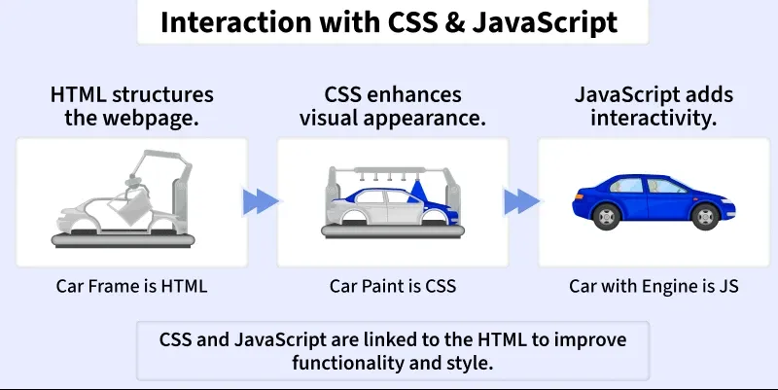
Interaction of HTML, CSS, and JavaScript
HTML structures the webpage and defines content elements.
CSS enhances visual appearance like colors, fonts, and layout.
JavaScript adds interactivity and dynamic features.
Together, they make web pages functional, attractive, and user-friendly
Notes:
HTML acts as the car’s frame, forming the foundation.
CSS is like the car’s paint, giving it style and design.
JavaScript is the engine, adding motion and behaviour.
When combined, they create a complete, interactive website.

Slide 14
HTML Elements and HTML Tags

Slide 15
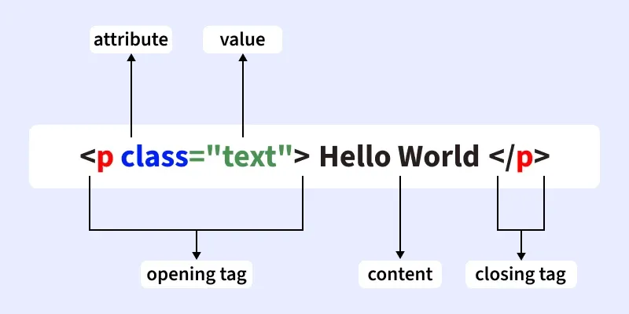
An HTML element is the complete structure, including the opening tag, content (if any), and the closing tag

Slide 16
HTML Attributes
Attributes provide additional information about an element. They are placed inside the opening tag and are written as name="value". Common attributes include class, id, href, and src.
Attributes are written inside the opening tag of an element.
They are written as name="value" pairs.
Most HTML elements can have one or more attributes.
Attributes help in customizing how elements behave or display in a browser.
Attribute values are usually enclosed in double quotes (").

Slide 17
HTML Attributes
HTML Attributes are special words used within the opening tag of an HTML element. They provide additional information about HTML elements. HTML attributes are used to configure and adjust the element's behaviour, appearance, or functionality in a variety of ways.
Each attribute has a name and a value, formatted as name="value".
Attributes tell the browser how to render the element or how it should behave during user interactions.
<tagname attribute_name = "attribute_value"> content... </tagname>

Slide 18
Components of Attribute
1. attribute_name: This is the name of the attribute, which specifies what kind of additional information or property you are defining for the element. Common attribute names include href, src, class, id, etc.
2. attribute_value: The value is assigned to the attribute to define the specific setting or behavior. It is always placed in quotes.

Slide 19
Event Attributes - These define the actions to be taken on specific browser events.
Input Attributes - Specific to input elements within <form> tags.
Image Attributes - Specific to the <img> element for handling images.
Link Attributes - Specific to linking elements like <a> and <link>.
Table Attributes - Used with table elements like <table> , <th> , <tr> , and <td>.
Style Attributes - Define styles directly on an element.

Slide 20
<!DOCTYPE html>
<html>
<head>
<title>HTML img src Attribute</title>
</head>
<body>
<img src=
"https://media.geeksforgeeks.org/wp-content/cdn-uploads/Geek_logi_-low_res.png"
style="width:350px; height:auto;">
</body>
</html>

Slide 21
Tag : <img>
Attribute : src
Value of Attribute : "https://media.geeksforgeeks.org/wp-content/cdn-uploads/Geek_logi_-low_res.png"
Purpose : The <img> tag is used for embedding images in an HTML page. The src attribute within the <img> tag specifies the path to the image file you wish to display. This attribute is crucial as it directs the browser to the image’s location on the internet or a local directory.

Slide 22
1. HTML alt Attribute
The alt attribute in HTML provides alternative text for an image if the image cannot be displayed. It improves accessibility and provides context for screen readers.
<!DOCTYPE html>
<html>
<head>
<title>HTML img alt Attribute</title>
</head>
<body>
<img src=
"https://media.geeksforgeeks.org/wp-content/cdn-uploads/Geek_logi_-low_res.png"
style="width:350px; height:auto;"
alt="The Logo"><br>
</body>
</html>

Slide 23
2. HTML width and height Attribute
The width and height Attribute is used to adjust the width and height of an image(in pixels). <!DOCTYPE html>
<html lang="en">
<head>
<title>Width and Height</title>
</head>
<body>
<img src=
"https://media.geeksforgeeks.org/wp-content/cdn-uploads/Geek_logi_-low_res.png"
width="300px"
height="100px">
</body>
</html>

Slide 24
3. HTML id Attribute
The id attribute in HTML assigns a unique identifier to an element, allowing it to be targeted by CSS and JavaScript for styling and manipulation purposes.
<!DOCTYPE html>
<html>
<head>
<style>
#geeks {
color: green;
}
</style>
</head>
<body>
<h1 id="geeks">Welcome to GeeksforGeeks</h1>
</body>
</html>

Slide 25
4. HTML title Attribute
The title attribute is used to explain an element by hovering the mouse over it. The behavior differs with various elements but generally, the value is displayed while loading or hovering the mouse pointer over it.
<!DOCTYPE html>
<html>
<head>
<title>HTML title Attribute</title>
</head>
<body>
<h3 title="Hello GeeksforGeeks">
Hover to see the effect
</h3>
</body>
</html>

Slide 26
5. HTML href Attribute
The href attribute in HTML, used with the <a> tag, specifies a link destination. Clicking the linked text navigates to this address. Adding `target="_blank"` opens it in a new tab.
<!DOCTYPE html>
<html>
<head>
<title>link Attribute</title>
</head>
<body>
<a href="https://www.geeksforgeeks.org/">
Click to open in the same tab
</a><br>
<a href="https://www.geeksforgeeks.org/"
target="_blank">
Click to open in a different tab
</a>
</body>
</html>

Slide 27
6. HTML style Attribute
The style attribute is used to provide various CSS effects to the HTML elements such as increasing font-size, changing font-family, coloring, etc.
<!DOCTYPE html>
<html>
<head>
<title>style Attribute</title>
</head>
<body>
<h2 style="font-family:Chaparral Pro Light;">
Hello GeeksforGeeks.
</h2>
<h3 style="font-size:20px;">
Hello GeeksforGeeks.
</h3>
<h2 style="color:#8CCEF9;">
Hello GeeksforGeeks.
</h2>
<h2 style="text-align:center;">
Hello GeeksforGeeks.
</h2>
</body>
</html>

Slide 28
TAG

Slide 29
HTML p Tag
The <p> tag in HTML is used to define a paragraph of text. It automatically adds space before and after the content, making the text easier to read and well-structured.
The <p> tag is a block-level element used for displaying text in separate paragraphs.
Browsers automatically add line breaks and spacing before and after each <p> tag.

Slide 30
<html>
<body>
<p>Welcome to GeeksforGeeks</p>
</body>
</html>

Slide 31
Styling Paragraphs
<!DOCTYPE html>
<html lang="en">
<head>
<style>
p {
color: green;
font-size: 30px;
font-weight: 700;
}
</style>
</head>
<body>
<p>This is paragraph element</p>
</body>
</html>

Slide 32
Aligning Paragraph
The HTML <p> can be aligned with the CSS property text- align.
<!DOCTYPE html>
<html>
<head>
</head>
<body>
<p style="text-align: center;">This is paragraph element</p>
</body>
</html>

Slide 33
2.HTML a Tag
The <a> tag defines a hyperlink that connects one page or resource to another. Its key attribute, href, specifies the destination URL where users are directed upon clicking.
Can link to web pages, email addresses, phone numbers, or sections within the same page.
Supports attributes like target, rel, and download for enhanced functionality.

Slide 34
<!DOCTYPE html>
<html>
<body>
<a href="https://www.geeksforgeeks.org/html/html-tutorial/" target="_blank">
HTML Tutorial
</a>
</body>
</html>

Slide 35
<a href = "link"> Link Name </a>
By default, links appear as follows in all browsers:
Unvisited links: underlined and blue.
Visited links: underlined and purple.
Active links: underlined and red.

Slide 36
3.HTML br Tag
The <br> tag in HTML is used to create a line break in the text, causing the content that follows it to appear on a new line.
<!DOCTYPE html>
<html>
<body>
<p>Dear Reader, <br>This is printed after a line break.</p>
</body>
</html>

Slide 37
<img src=“nameofimage.jpg” alt=“error” height=“500” width=“600”>

Slide 38
<a href=“https://www.google.com">CodeBrainer</a>

Slide 39
<!DOCTYPE html>
<html>
<head>
<title>First Page</title>
</head>
<body>
<h1>GeeksforGeeks</h1>
<p>A Computer Science Portal for Geeks</p> <img src=“nameofimage.jpg” alt=“error” height=“” width=“”>
<a href=“website name”> FB </a>
</body>
</html>

Slide 40
HTML Block Elements and Text Elements
1. HTML Elements
An HTML element is a building block of a web page. It is written using tags.
HTML elements are mainly divided into two types:
Block Elements
Text (Inline) Elements

Slide 41
. Block Elements
A block element is an HTML element that starts on a new line and takes the full width of the page.
Block elements create separate sections or blocks on the web page.
Characteristics
✔ Always starts on a new line ✔ Takes full width of the page ✔ Can contain other HTML elements

Slide 42
Examples of Block Elements
Element | Description
<h1> to <h6> | Headings
<p> | Paragraph
<div> | Division or section
<ul> | Unordered list
<ol> | Ordered list
<li> | List item
<table> | Table

Slide 43
<!DOCTYPE html>
<html>
<body>
<h1>Welcome to HTML</h1>
<p>This is a paragraph.</p>
<div>This is a division block.</div>
</body>
</html>
Notes:
Each element appears on a new line because they are block elements.

Slide 44
3. Text Elements (Inline Elements)
A text element (inline element) is an element that does not start on a new line.
It only takes the width required for the content.
These elements are usually used inside block elements.
Characteristics
✔ Does not start on a new line
✔ Takes only required space
✔ Used to format text

Slide 45
Examples of Text (Inline) Elements
Element | Description
<b> | Bold text
<i> | Italic text
<u> | Underline text
<strong> | Important text
<em> | Emphasized text
<span> | Inline container
<a> | Hyperlink
<img> | Image

Slide 46
<!DOCTYPE html>
<html>
<body>
<p>This is <b>bold</b> text.</p>
<p>This is <i>italic</i> text.</p>
<p>This is <u>underlined</u> text.</p>
</body>
</html>
Notes:
The words bold, italic, underline appear in the same line because they are inline elements.

Slide 47
Difference Between Block and Inline Elements
Feature | Block Element | Inline Element
Line | Starts on new line | Same line
Width | Full width | Only required width
Usage | Structure of page | Text formatting
Example | <p>, <div> | <b>, <i>

Slide 48
ACTIVITY
write an HTML program that includes:
One heading
One paragraph
Use bold, italic and underline text
Use a div block

Slide 49
HTML Character Reference
A Character Reference in HTML is used to display special characters or reserved symbols in a web page.
Some characters like <, >, and & are reserved in HTML.If we write them directly, the browser may treat them as HTML tags or commands.
To display them correctly, character references (HTML entities) are used.

Slide 50
Syntax of Character Reference
There are two types of character references.
1. Using Entity Name
&entity_name;
Example:&lt;
2. Using Entity Number
&#entity_number;
Example: &#60;
Both will display the same symbol.

Slide 51
3. Common Character References
Character | Entity Name | Entity Number
< | &lt; | &#60;
> | &gt; | &#62;
& | &amp; | &#38;
" | &quot; | &#34;
' | &apos; | &#39;
Notes:
5 &lt; 10
Output:
5 < 10

Slide 52
4. Non-Breaking Space
A non-breaking space is used to create extra space between words.
Characterreference:
&nbsp;
Example:
<p>Hello&nbsp;&nbsp;&nbsp;World</p>
Output:Hello World

Slide 53
5. Currency Character References
Symbol | HTML Code
₹ | &#8377;
$ | &dollar;
€ | &euro;
£ | &pound;
¥ | &yen;
<p>Price: &#8377;1000</p>
Output:
Price: ₹1000

Slide 54
6. Mathematical Character References
Symbol | HTML Code
× | &times;
÷ | &divide;
± | &plusmn;
≤ | &le;
≥ | &ge;
<p>10 &times; 5 = 50</p>
Output:
10 × 5 = 50

Slide 55
HTML Program
<!DOCTYPE html>
<html>
<body>
<h2>Character Reference Example</h2>
<p>5 &lt; 10</p>
<p>10 &gt; 5</p>
<p>Tom &amp; Jerry</p>
<p>Price: &#8377;500</p>
<p>10 &times; 5 = 50</p>
</body>
</html>

Slide 56
Write an HTML program to display:
A < B
Tom & Jerry
10 × 20 = 200
Price = ₹500

Slide 57
HTML Lists
An HTML list organizes content into ordered or unordered formats, making information clear and easy to read.
HTML lists organize content using tags like <ul>, <ol> & <li>.
They improve readability by presenting data in a structured format.

Slide 58
Tag | Description
<ul> | Defines an unordered list.
<ol> | Defines an ordered list.
<li> | Defines a list item.
<dl> | Defines a description list.
<dt> | Defines a term in a description list.
<dd> | Details the term in a description list.

Slide 59
Types of HTML Lists
1. Unordered List or Bulleted List
Unordered lists display items as bulleted points where the order of items does not matter, using the <ul> and <li> tags.
Unordered lists are ideal for scenarios where the sequence of the items is not important.
The unordered list items are marked with bullets, also known as bulleted lists.
An unordered list starts with the <ul> tag, and each list item begins with the <li> tag.

Slide 60
Syntax:
<ul>
<li>Item 1</li>
<li>Item 2</li>
<li>Item 3</li>
</ul>

Slide 61
<!DOCTYPE html>
<html>
<head>Unordered List</head>
<body>
<h2>Grocery list</h2>
<ul>
<li>Bread</li>
<li>Eggs</li>
<li>Milk</li>
<li>Coffee</li>
</ul>
</body>
</html>

Slide 62
2. HTML Ordered List
Ordered lists are used when the items need to follow a specific sequence.
In an ordered list, all list items are marked with numbers by default. An ordered list starts with the <ol> tag, and each list item begins with the <li> tag.
Attributes:
reversed: reversed defines that the order will be descending.
start: It defines from which number or alphabet the order will start.
type: It defines which type(1, A, a, I, and i) of the order you want in your list of numeric, alphabetic, or roman numbers.

Slide 63
<ol>
<li>Item1</li>
<li>Item2</li>
<li>Item3</li>
</ol>

Slide 64
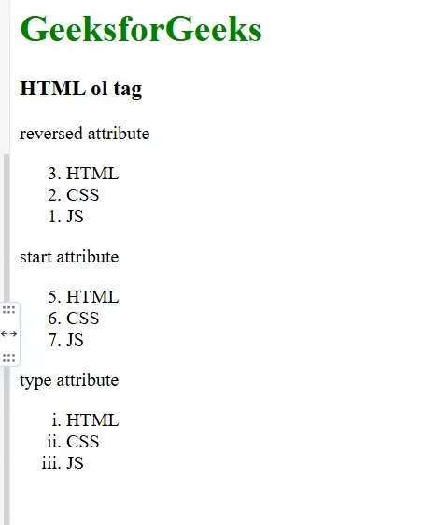

Slide 65
3. HTML Description List
A description list is a list of terms, with a description of each term. Description lists are less common but very useful for definitions, glossaries, or any other key-value pairs of items.
The <dl> tag defines the description list, the <dt> tag defines the term name, and the <dd> tag describes each term.
Here, <dt> (description term) is used for the term being defined, and <dd> (description details) is used for the description.

Slide 66
<dl>
<dt>Item 1</dt>
<dd>Description of Item 1 </dd>
<dt>Item 2</dt>
<dd>Description of Item 2</dd>
</dl>

Slide 67
<body>
<h2>A Description List</h2>
<dl>
<dt>Coffee</dt>
<dd>- 500 gms</dd>
<dt>Milk</dt>
<dd>- 1 ltr Tetra Pack</dd>
</dl>
</body>
</html>

Slide 68
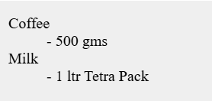
A Description List
Coffee
- 500 gms
Milk
- 1 ltr Tetra Pack

Slide 69
<body>
<h1 style="color: green">GeeksforGeeks</h1>
<h3>HTML ol tag</h3>
<p>reversed attribute</p>
<ol reversed>
<li>HTML</li>
<li>CSS</li>
<li>JS</li>
</ol>
<p>start attribute</p>
<ol start="5">
<li>HTML</li>
<li>CSS</li>
<li>JS</li>
</ol>
<p>type attribute</p>
<ol type="i">
<li>HTML</li>
<li>CSS</li>
<li>JS</li>
</ol>
</body>
</html>

Slide 70
HTML Images
Images make a website more attractive and informative.In HTML,
images are displayed using the <img> tag.
The <img> tag is an empty tag, meaning it does not require a closing tag.
There are two ways to insert the images into a webpage:
By providing a full path or address (URL) to access an internet file.
By providing the file path relative to the location of the current web page file.

Slide 71
<img> tag is used to embed an image in a webpage.
src specifies the image source URL.
alt provides descriptive text if the image cannot be displayed.

Slide 72
Attribute | Description
src | Specifies the path to the image file.
alt | Provides alternate text for the image, useful for accessibility and when the image cannot be displayed.
crossorigin | Allows importing images from third-party sites with cross-origin access, typically used with canvas.
height | Specifies the height of the image.
width | Specifies the width of the image.

Slide 73
HTML Image tag - alt Attribute
The alt attribute in the <img> tag provides alternative text when an image cannot be displayed and improves accessibility.
Displays text if the image fails to load.
Helps users with slow connections or broken image links.
Essential for screen readers and accessibility support.
<body>
<img src=
"https://media.geeksforgeeks.org/wp-content/cdn-uploads/201907101022/download3.png"
alt="This is GeeksforGeeks logo" />
</body>

Slide 74
Set Image Size - Width and Height Attribute
The width and height attributes in the <img> tag define the size of an image, with values specified in pixels by default.
Control the displayed width and height of an image.
Values are specified in pixels.
Help maintain consistent layout and prevent page shifting.
<img src=
"https://media.geeksforgeeks.org/wp-content/cdn-uploads/20190710102234/download3.png"
alt="GeeksforGeeks logo"
width="300"
height="300" />

Slide 75
Setting Style of an Image
The border attribute is used to control the border appearance of an image.
Specifies the thickness of the image border.
Setting border="0" removes the border completely.
<img src=
"https://media.geeksforgeeks.org/wp-content/cdn-uploads/20190710102234/download3.png"
alt="GeeksforGeeks logo"
width="200"
height="200"
border="5" />

Slide 76
Set Image Alignment
Image alignment in HTML controls how an image is positioned within a webpage layout.
Alignment is set using the align attribute in the <img> tag.
Common values include left, right, and center.
Helps improve page layout and visual presentation.
<img
src="https://media.geeksforgeeks.org/wp-content/cdn-uploads/20190710102234/download3.png"
alt="GeeksforGeeks logo"
align="right" />

Slide 77
HTML <section> Tag
The section tag is used when requirements of two headers or footers or any other section of documents are needed. Section tag grouped the generic block of related contents.
The main advantage of the section tag is, it is a semantic element, that describes its meaning to both the browser and the developer.

Slide 78
<section> Section Contents </section>

Slide 79

<!DOCTYPE html> <html> <head> <title>Web Page</title> </head> <body> <section> <h2>About College</h2> <p>Our college offers various courses in science and technology.</p> </section> <section> <h2>Courses Offered</h2> <p>BCA, BSc Computer Science, BCom.</p> </section> </body> </html>

Slide 80
Nested Section tag:
The section tag can be nested. The font size of subsection is smaller than section tag if the text contains the same font property. The subsection tag is used for organizing complex documents. A rule of thumb is that section should logically appear in outline of the document.

Slide 81
HTML article Tag

Slide 82
Lab Assignment 1

Slide 83
Table
<table> <tr> <td>Emil</td> <td>Tobias</td> <td>Linus</td> </tr> <tr> <td>16</td> <td>14</td> <td>10</td> </tr> </table>

Slide 84
Table Headers
<table style="width:100%"> <tr style="height:200px"> <th>Person 1</th> <th>Person 2</th> <th>Person 3</th> </tr> <tr> <td>Emil</td> <td>Tobias</td> <td>Linus</td> </tr> <tr> <td>16</td> <td>14</td> <td>10</td> </tr> </table>

Slide 85
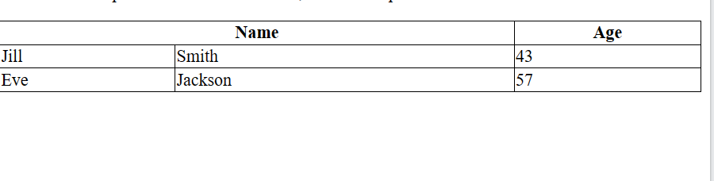
<table style="width:100%">
<tr>
<th colspan="2">Name</th>
<th>Age</th>
</tr>
<tr>
<td>Jill</td>
<td>Smith</td>
<td>43</td>
</tr>
<tr>
<td>Eve</td>
<td>Jackson</td>
<td>57</td>
</tr>
</table>

Slide 86
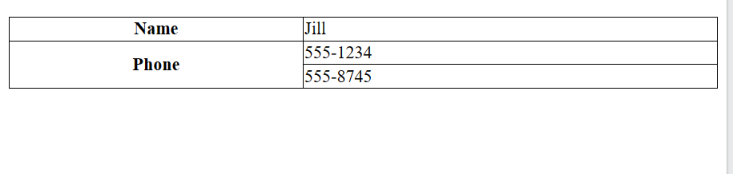
Row Span
<table style="width:100%">
<tr>
<th>Name</th>
<td>Jill</td>
</tr>
<tr>
<th rowspan="2">Phone</th>
<td>555-1234</td>
</tr>
<tr>
<td>555-8745</td>
</tr>
</table>
a | b | C
 | d | e | F
j | i | h | g

Slide 87
Linking Another Pages
<!DOCTYPE html>
<html>
<head>
<title>Links in HTML</title>
</head>
<body>
<a href="https://www.google.com" >Visit Google</a>
</body>
</html>

Slide 88
Inserting Image
<!DOCTYPE html>
<html>
<head>
<title>Image in HTML</title>
</head>
<body>
<h2>My Favorite Image</h2>
<img src="image.jpg" alt="Sample Image" width="300" height="200">
</body>
</html>

Slide 89

Lab Assignment 2
Resume
Name | a
Photograph
Age | 1
Phone No | 223
 | 333

Slide 90
HTML Formatting Elements
Formatting elements were designed to display special types of text:
<b> - Bold text
<strong> - Important text
<i> - Italic text
<em> - Emphasized text
<mark> - Marked text
<small> - Smaller text
<del> - Deleted text
<ins> - Inserted text
<sub> - Subscript text
<sup> - Superscript text

Slide 91
Formatting Elements
<!DOCTYPE html>
<html>
<head>
<title>Text Formatting</title>
</head>
<body>
<p><b>Bold Text</b></p>
<p><i>Italic Text</i></p>
<p><u>Underlined Text</u></p>
<p>X<sup>2</sup> + Y<sub>2</sub> = Z<sup>2</sup></p>
</body>
</html>

Slide 92
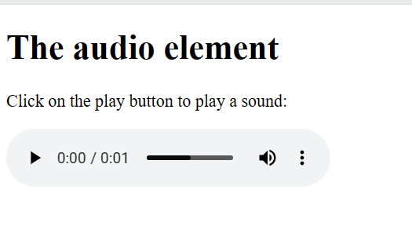
<!DOCTYPE html>
<html>
<body>
<h1>The audio element</h1>
<p>Click on the play button to play a sound:</p>
<audio controls>
<source src="horse.ogg" type="audio/ogg">
<source src="horse.mp3" type="audio/mpeg">
Your browser does not support the audio element.
</audio>
</body>
</html>

Slide 93
Embedding Video
<!DOCTYPE html>
<html>
<head>
<title>Video in HTML</title>
</head>
<body>
<h2>Watch this Video</h2>
<video width="400" controls>
<source src="video.mp4" type="video/mp4">
Your browser does not support the video tag.
</video>
</body>
</html>

Slide 94
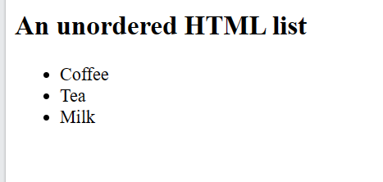
Un ordered List
<!DOCTYPE html>
<html>
<body>
<h2>An unordered HTML list</h2>
<ul>
<li>Coffee</li>
<li>Tea</li>
<li>Milk</li>
</ul>
</body>
</html>

Slide 95
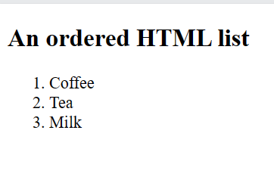
Ordered List
<!DOCTYPE html>
<html>
<body>
<h2>An ordered HTML list</h2>
<ol>
<li>Coffee</li>
<li>Tea</li>
<li>Milk</li>
</ol>
</body>
</html>

Slide 96
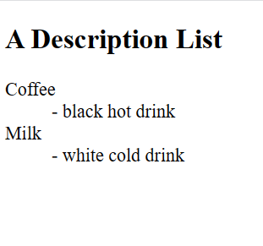
Detailed List
<!DOCTYPE html>
<html>
<body>
<h2>A Description List</h2>
<dl>
<dt>Coffee</dt>
<dd>- black hot drink</dd>
<dt>Milk</dt>
<dd>- white cold drink</dd>
</dl>
</body>
</html>

Slide 97
AMITY UNIVERSITY H1 BENGALURU H2 DEVANHALLI H2
REPORT BY H4
DATE H4
TIME H5
VENUE H5
LIST OF GUEST OL
KEY TAKE AWAYS UL
CONCLUSION P

Slide 98
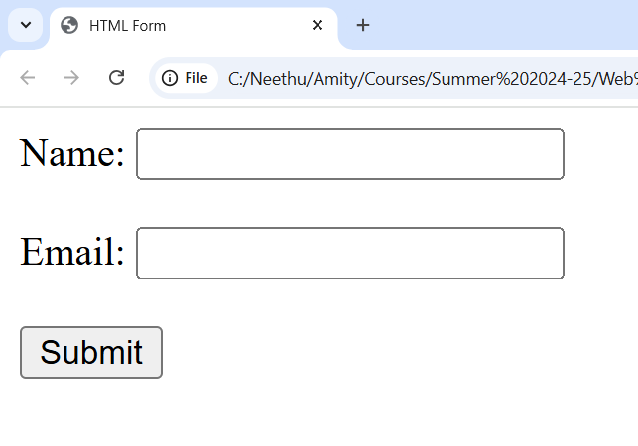
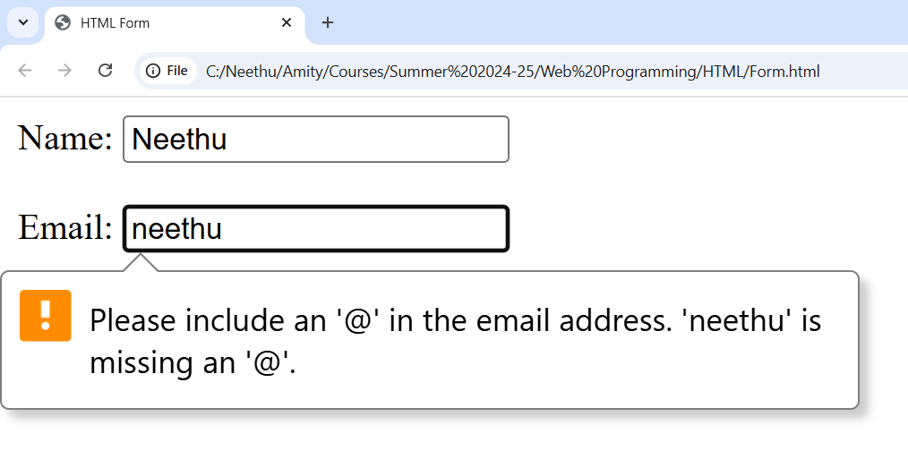
Creating Form
<!DOCTYPE html>
<html>
<head>
<title>HTML Form</title>
</head>
<body>
<form>
<label>Name:</label>
<input type="text" name="name"><br><br>
<label>Email:</label>
<input type="email" name="email"><br><br>
<input type="submit" value="Submit">
</form>
</body>
</html>

Slide 99
<input type="password" id="password" name="password" required><br><br>
<label>Gender:</label><br>
<input type="radio" id="male" name="gender" value="Male">
<label for="male">Male</label>
<input type="radio" id="female" name="gender" value="Female">
<label for="female">Female</label>
<input type="radio" id="other" name="gender" value="Other">
<label for="other">Other</label><br><br>
<label>Hobbies:</label><br>
<input type="checkbox" name="hobbies" value="Reading"> Reading
<input type="checkbox" name="hobbies" value="Music"> Music
<input type="checkbox" name="hobbies" value="Sports"> Sports
<input type="checkbox" name="hobbies" value="Travel"> Travel<br><br>

Slide 100
<label for="country">Country:</label><br>
<select id="country" name="country">
<option value="">--Select--</option>
<option value="India">India</option>
<option value="USA">USA</option>
<option value="UK">UK</option>
<option value="Canada">Canada</option>
</select><br><br>

Slide 101
<label for="profile">Upload Profile Picture:</label><br>
<input type="file" id="profile" name="profile"><br><br>
<label for="comments">Comments:</label><br>
<textarea id="comments" name="comments" rows="4" cols="40"></textarea><br><br>
<input type="submit" value="Submit">
<input type="reset" value="Reset">

Slide 102
Assignment:
The type attribute in the <input> tag specifies the kind of input the user is expected to enter.
List out all available type values in HTML.

Slide 103
Lab Assignment:
Design an HTML form titled "University Admission Form" that collects the following student details:
Full Name
Date of Birth
Gender (Radio buttons)
Course Applied For (Dropdown: B.Sc, B.A, B.Com, B.Tech, M.Sc, M.A, etc.)
Email Address
Phone Number
Address (Textarea)
12th Grade Percentage (Number input)
Upload 12th Marksheet (File input)
Select Subjects (Checkboxes: Physics, Chemistry, Maths, Biology, Computer Science, Economics)
Preferred Mode of Admission (Radio: Entrance Exam / Merit)

Slide 104
Semantic Elements:
Semantic elements have meaningful names that tell about the type of content. For example, header, footer, table, … etc. HTML5 introduces many semantic elements as mentioned below which make the code easier to write and understand for the developer as well as instruct the browser on how to treat them.
<header>
<footer>
<nav>
<main>
<section>
<article>
<aside>
<details> and <summary>
<figcaption>
<figure>
<mark>

Slide 105
article:
It contains independent content which doesn’t require any other context blog Post, Newspaper Article, etc.

Slide 106
<!DOCTYPE html>
<html>
<head>
<title>Article Tag</title>
</head>
<body>
<article>
<h1>GeeksforGeeks</h1>
<p>A Computer Science Portal for Geeks</p>
</article>
</body>
</html>

Slide 107
Aside:
It is used to place content in a sidebar i.e. aside from the existing content. It is related to surrounding content

Slide 108
<!DOCTYPE html> <html> <head> <title>Aside Tag</title> </head> <body> <p>GeeksforGeeks is a Computer Science Portal</p> <aside> <h4>GeeksForGeeks</h4> <p>GeeksforGeeks is a computer Science platform where you can learn good programming. </p> </aside> </body> </html>

Slide 109
Header:
As the name suggests, it is for the header of a section introductory of a page. There can be multiple headers on a page.

Slide 110
<!DOCTYPE html>
<html>
<head>
<title>Header Tag</title>
</head>
<body>
<article>
<header>
<h1>GeeksforGeeks</h1>
<h3>GeeksforGeeks</h3>
<p>A computer Science portal</p>
</header>
</article>
</body>

Slide 111
Footer:
Footer located at the bottom of any article or document, they can contain contact details, copyright information etc. There can be multiple footers on a page.

Slide 112
<!DOCTYPE html> <html> <head> <title>footer Tag</title> </head> <body> <footer> <p> Posted by: GeeksforGeeks </p> <p> Contact: <a href= "https://www.geeksforgeeks.org"> geeksforgeeks.org </a>. </p> </footer> </body> </html>

Slide 113
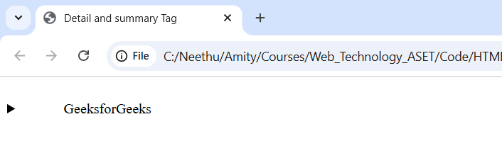
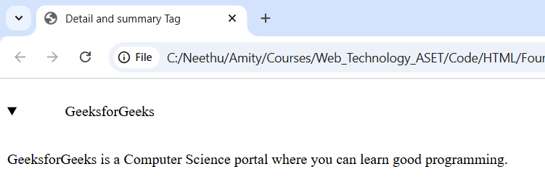
Details and Summary:
“details” defines additional details that the user can hide or view. “summary” defines a visible heading for a “details” element.

Slide 114
<!DOCTYPE html>
<html>
<head>
<title>Detail and summary Tag</title>
</head>
<body>
<details>
<summary>
GeeksforGeeks
</summary>
<p>GeeksforGeeks is a Computer Science portal where you can learn good programming.
</p>
</details>
</body>
</html>

Slide 115
Figure and Figcaption:
These are used to add an image to a web page with a small description.

Slide 116
<!DOCTYPE html>
<html>
<head>
<title>Figcaption Tag</title>
</head>
<body>
<h2>GeeksforGeeks</h2>
<figure>
<img src="4.jpg"
alt="gfg"
style="width:20%">
<figcaption>
GeeksforGeeks Logo
</figcaption>
</figure>
</body>
</html>

Slide 117
Section:
A page can be split into sections like Introduction, Contact Information, Details, etc and each of these sections can be in a different section tag.

Slide 118
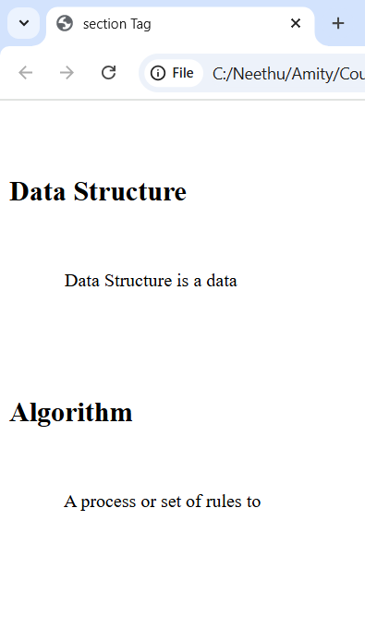
<!DOCTYPE html>
<html>
<head>
<title>section Tag</title>
</head>
<body>
<section>
<h1>Data Structure</h1>
<p>
Data Structure is a data
</p>
</section>
<section>
<h1>Algorithm</h1>
<p>
A process or set of rules to
</p>
</section>
</body>
</html>

Slide 119
nav:
It is used to define a set of navigation links in the form of a navigation bar or nav menu.

Slide 120
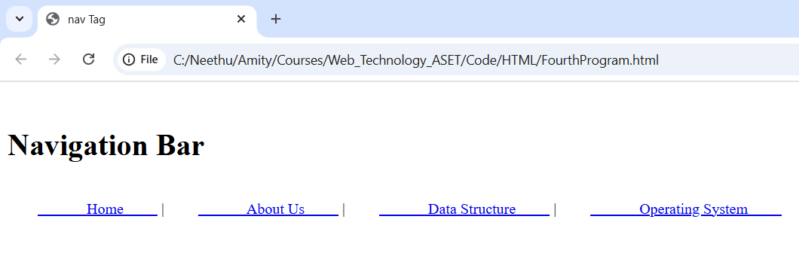
<!DOCTYPE html> <html> <head> <title>nav Tag</title> </head> <body> <h1>Navigation Bar</h1> <nav> <a href="/home/"> Home </a> | <a href="/about-us/"> About Us </a> | <a href="/data-structure/"> Data Structure </a> | <a href="/operating-system/"> Operating System </a> </nav> </body> </html>

Slide 121
Mark:
It is used to highlight the text.

Slide 122
Tag | Description
<abbr> | Defines an abbreviation or acronym
<address> | Defines contact information for the author/owner of a document
<bdo> | Defines the text direction
<blockquote> | Defines a section that is quoted from another source
<cite> | Defines the title of a work
<q> | Defines a short inline quotation

Slide 123
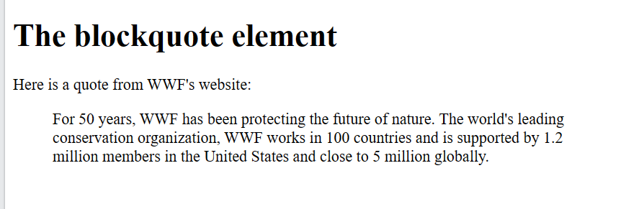
<!DOCTYPE html>
<html>
<body>
<h1>The blockquote element</h1>
<p>Here is a quote from WWF's website:</p>
<blockquote cite="http://www.worldwildlife.org/who/index.html">
For 50 years, WWF has been protecting the future of nature. The world's leading conservation organization, WWF works in 100 countries and is supported by 1.2 million members in the United States and close to 5 million globally.
</blockquote>
</body>
</html>

Slide 124
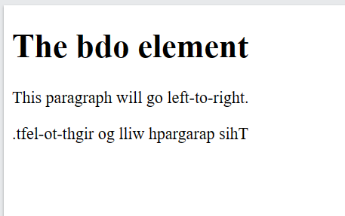
<!DOCTYPE html>
<html>
<body>
<h1>The bdo element</h1>
<p>This paragraph will go left-to-right.</p>
<p><bdo dir="rtl">This paragraph will go right-to-left.</bdo></p>
</body>
</html>

Slide 125
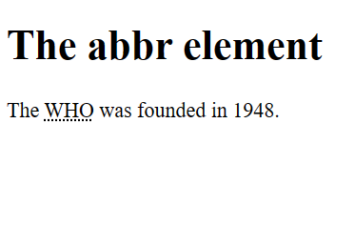
<!DOCTYPE html>
<html>
<body>
<h1>The abbr element</h1>
<p>The <abbr title="World Health Organization">WHO</abbr> was founded in 1948.</p>
</body>
</html>

Slide 126
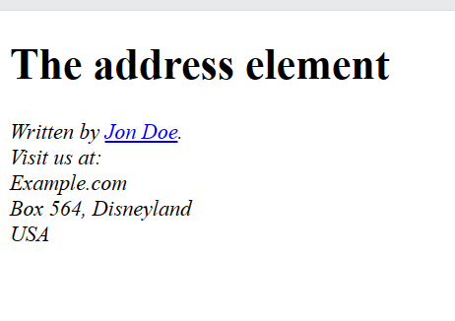
<!DOCTYPE html>
<html>
<body>
<h1>The address element</h1>
<address>
Written by <a href="mailto:webmaster@example.com">Jon Doe</a>.<br>
Visit us at:<br>
Example.com<br>
Box 564, Disneyland<br>
USA
</address>
</body>
</html>

Slide 127
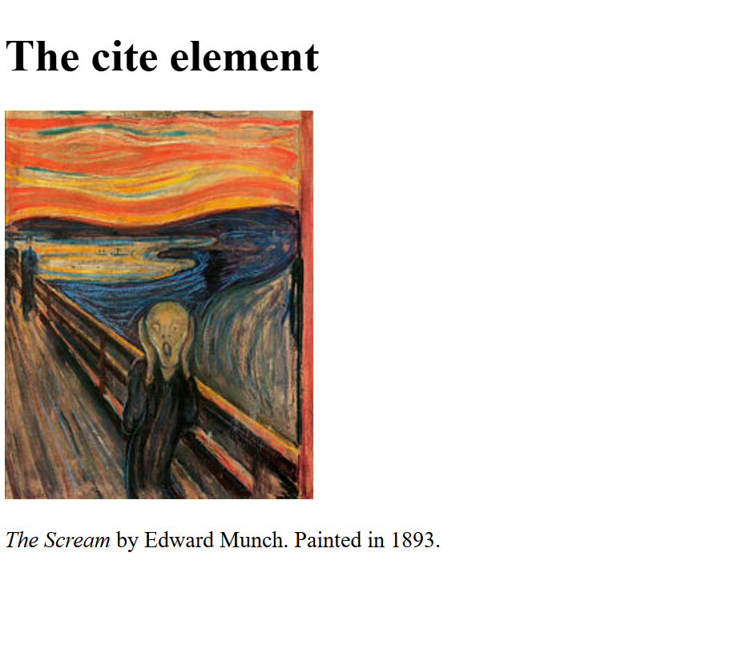
<html>
<body>
<h1>The cite element</h1>
<img src="img_the_scream.jpg" width="220" height="277" alt="The Scream">
<p><cite>The Scream</cite> by Edward Munch. Painted in 1893.</p>
</body>
</html>

Slide 128
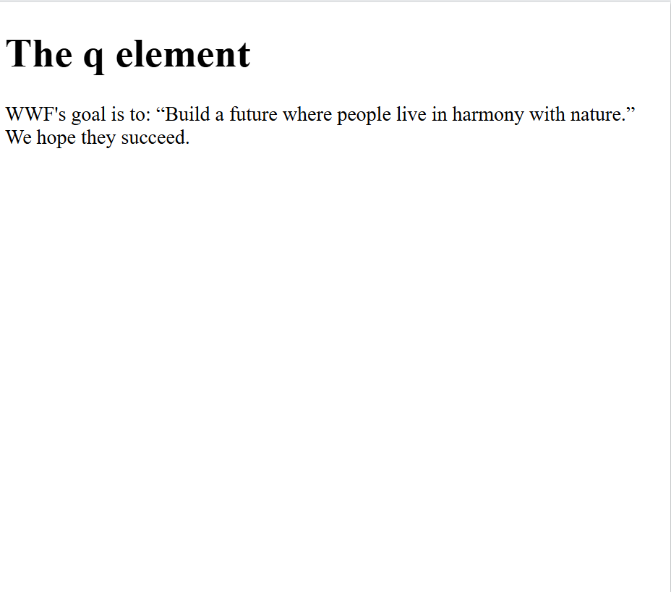
<html>
<body>
<h1>The q element</h1>
<p>WWF's goal is to:
<q>Build a future where people live in harmony with nature.</q>
We hope they succeed.</p>
</body>
</html>

